Slide 1



Pre-event Webinar
Joint Code Sprint 2021
February 17th to 19th, 2021
Martin Desruisseaux (ASF), Angelos Tzotsos (OSGeo), Tom Kralidis (OSGeo) and Gobe Hobona (OGC)
2021-02-12

Slide 2
Webinar Agenda
Welcome Remarks
Sponsor Remarks
Overview of participating OGC standards working groups
Overview of participating OSGeo projects
Overview of participating ASF projects
Questions & Answers

Slide 3
Invitation
The Open Geospatial Consortium (OGC), the Apache Software Foundation (ASF), and Open Source Geospatial Foundation (OSGeo) invite software developers to a joint Virtual Code Sprint on:
February 17th, 2021 from 7:00am EST until 5:30pm US Eastern Time.
February 18th, 2021 from 7:00am EST until 5:30pm US Eastern Time.
February 19th, 2021 from 7:00am EST until 5:30pm US Eastern Time.
What is a Code Sprint?
A collaborative and inclusive event driven by innovative and rapid programming with minimum process and organization constraints to support the development of new applications and open standards. (source: OGC Innovation Program policy)

Slide 4


Sponsors’ Remarks
Gold Sponsor:
Silver Sponsor:

Slide 5
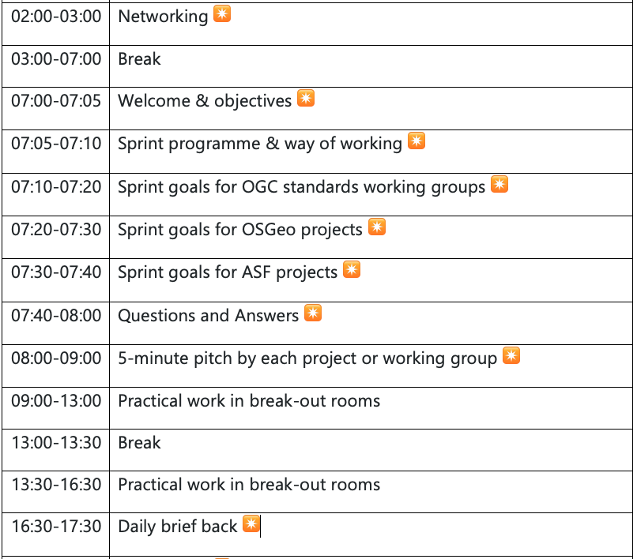
Sprint Agenda
Day 1 - February 17th

Slide 6
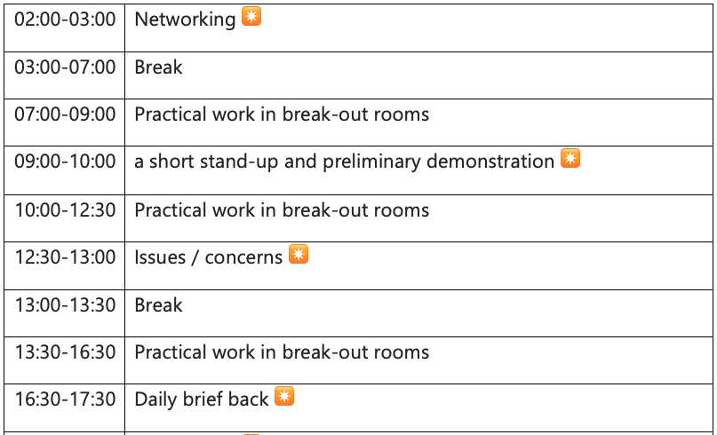
Sprint Agenda
Day 2 - February 18th

Slide 7
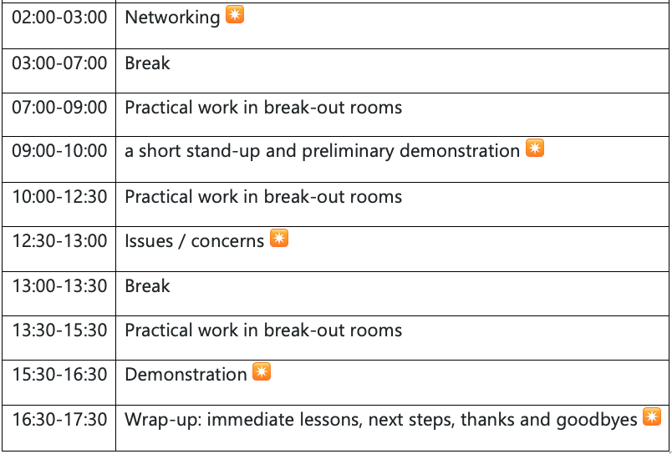
Sprint Agenda
Day 3 - February 19th

Slide 8
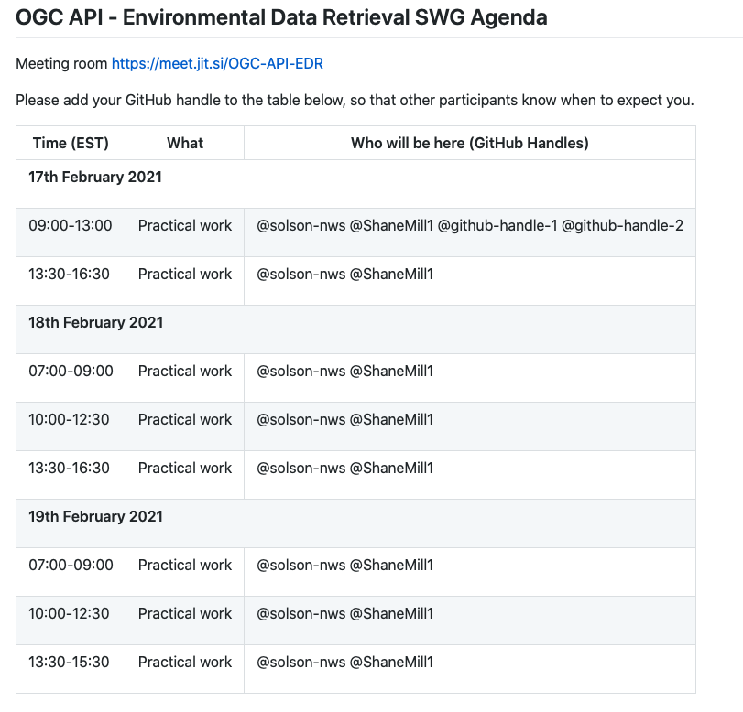
Breakout Agendas
An example

Slide 9
Which OGC Standards Working Groups do you regularly contribute to?
OGC API - Processes
GeoAPI
OGC API - Common
OGC API - Environmental Data Retrieval
OGC API - Features
OGC API - Tiles
OGC API - Records
GeoPose
OGC API - Coverages
OGC API - Styles
GeoXACML
GeoPackage
CDB
MapML

Slide 10
Which OSGeo projects do you regularly contribute to?
GeoHealthCheck
GeoNetwork
GeoNode
GeoServer
GeoTrellis
Mapbender
mapproxy
MapServer
MobilityDB
OSGeoLive
OWSLib
pdal
pgRouting
PostGIS
Proj
pycsw
pygeoapi
QGIS
Stetl
ZOO-Project

Slide 11
Which Apache projects do you regularly contribute to?
Projects
Work items for code sprint
Activemq
GeoSPARQL
CXF
Jena
Semantic GeoSpatial Web
Karaf
SIS
OGC filters (GeoAPI)
Tomcat
Superset

Slide 12
How everything fits together [1]
GeoNode
EDR API ETS
ldproxy
QGIS
GeoServer
PyWPS
pygeoapi
GDAL/OGR
GeoNetwork
Extracted from Registration
List
OWSLib
MapServer
NOAA EDR API
Apache SIS
[1] https://github.com/opengeospatial/joint-ogc-osgeo-asf-sprint-2021/blob/master/agenda-5-min-pitch.adoc

Slide 13
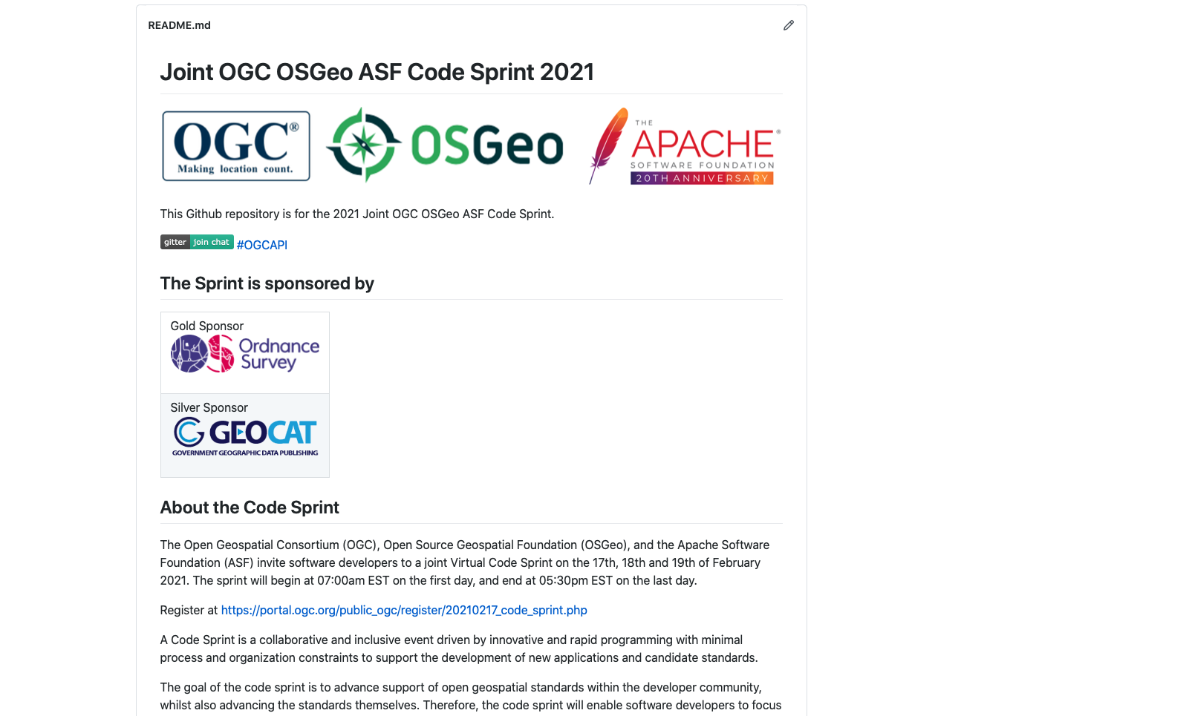
https://github.com/opengeospatial/joint-ogc-osgeo-asf-sprint-2021

Slide 14
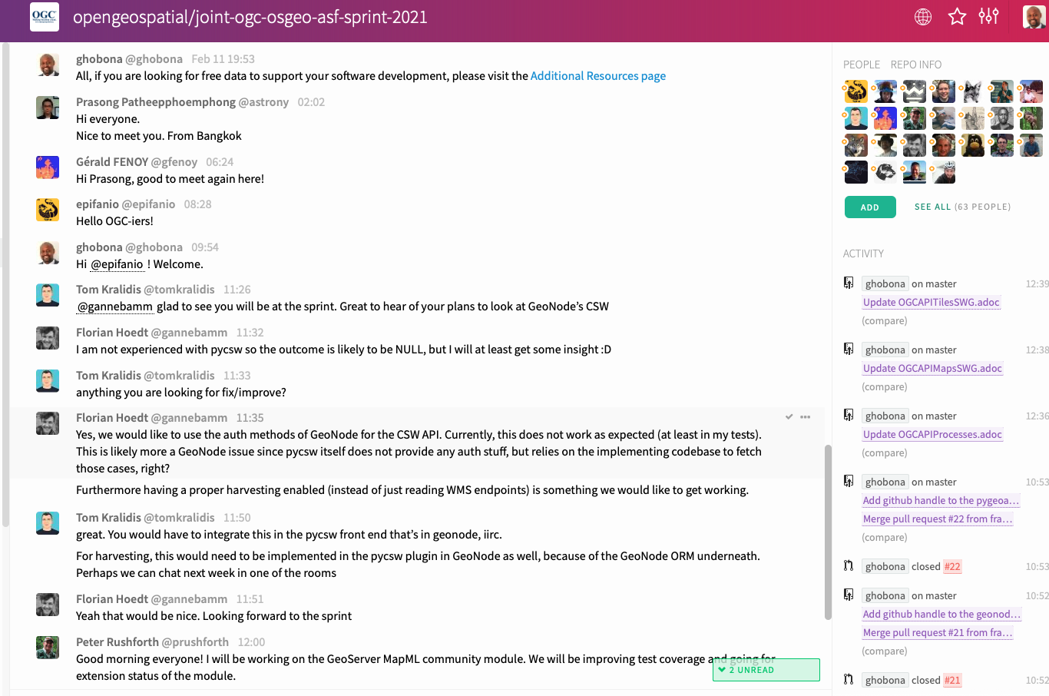
https://gitter.im/opengeospatial/joint-ogc-osgeo-asf-sprint-2021

Slide 15
Questions and Answers
?

Slide 16
Thank you
See you, virtually, on Wednesday 17 February 2021

